Slide 1
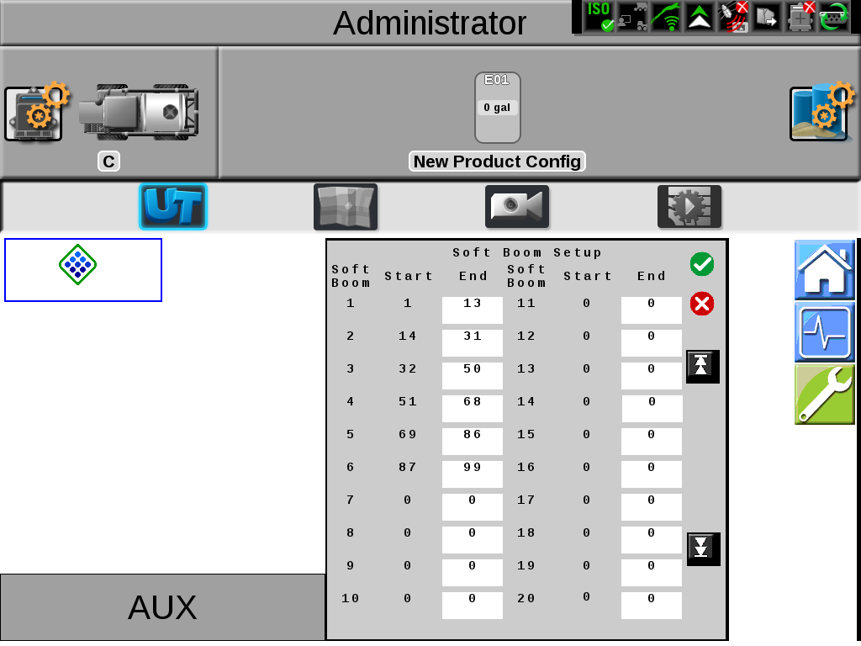
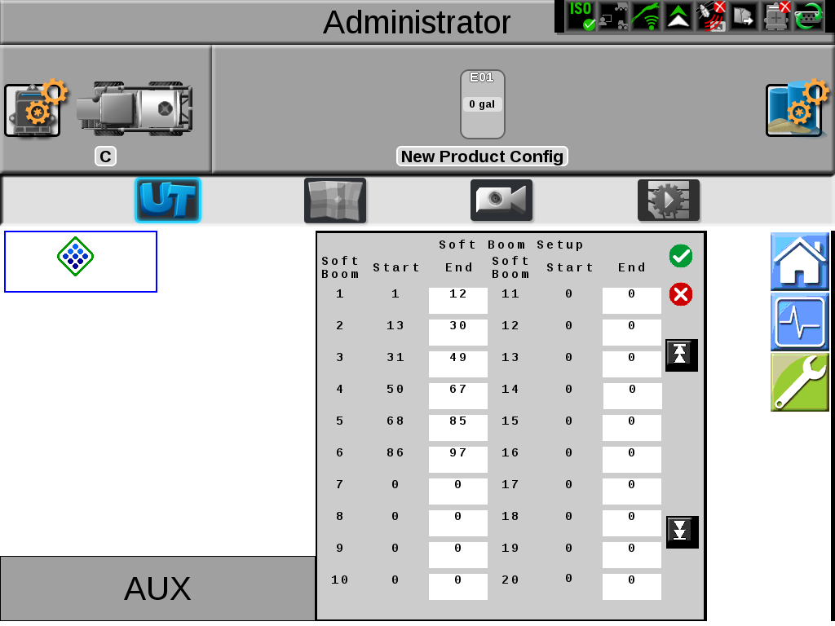
120’ Truss Boom 15” Nozzle Spacing
Fence Row Nozzles
NO Fence Row Nozzles

Slide 2


132’ Truss Boom 22” Nozzle Spacing
Fence Row Nozzles
NO Fence Row Nozzles

Slide 3


973 PT 120’, 20” Nozzle Spacing
With Fence Row Nozzles
No Fence Row Nozzles

Slide 4


9518 TF 60/90’, 15” Nozzle Spacing
With Fence Row Nozzles
NO Fence Row Nozzles

Slide 5


9518 TF 60/90’, 20” Nozzle Spacing
With Fence Row Nozzles
Without Fence Row Nozzles

Slide 6


9518 TF 100’, 15” Nozzle Spacing
With Fence Row Nozzles
NO Fence Row Nozzles

Slide 7


9518 TF 100’, 20” Nozzle Spacing
With Fence Row Nozzles
NO Fence Row Nozzles

Slide 8
9600 N 60/90’, 15” Nozzle Spacing
With Fence Row Nozzles
NO Fence Row Nozzles

Slide 9
9600 60/90’, 20” Nozzle Spacing
With Fence Row Nozzles
NO Fence Row Nozzles

