Slide 1
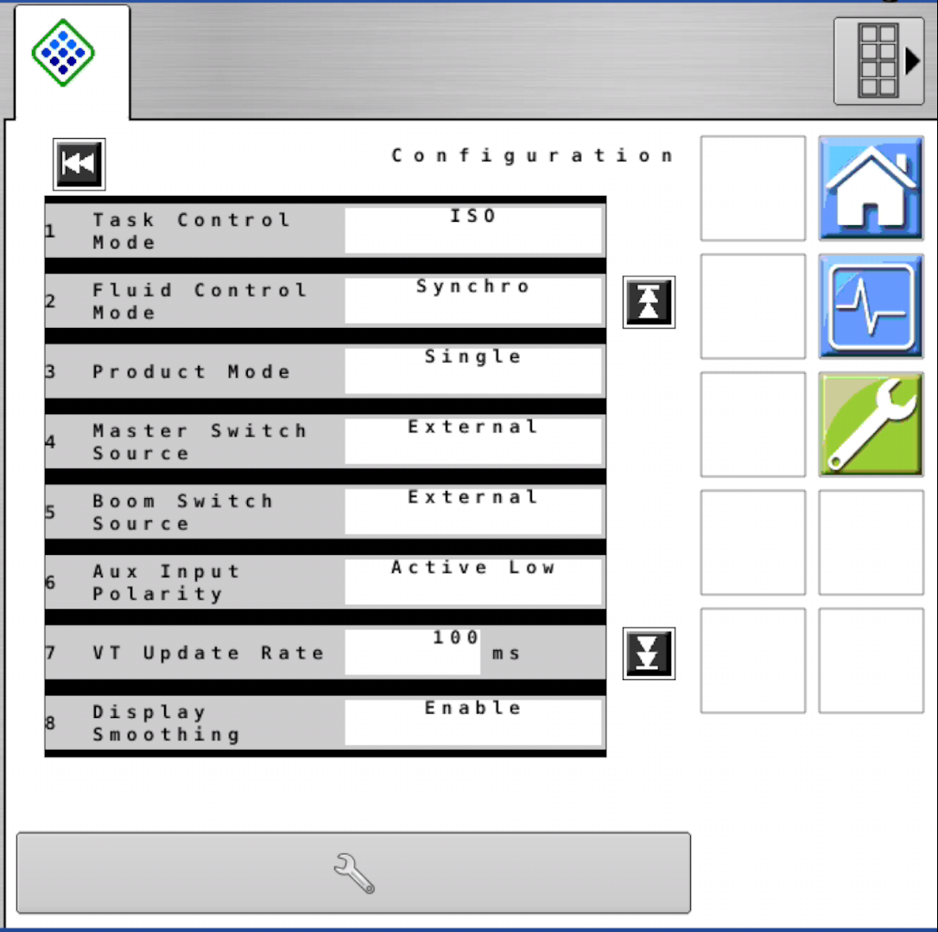
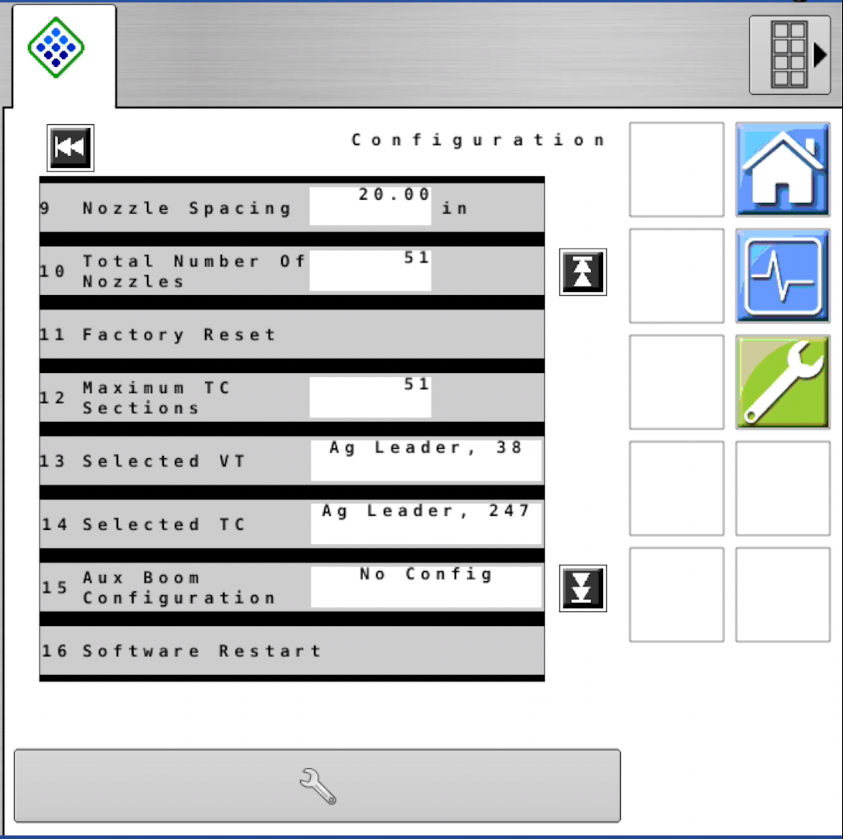
Wrench > Menu > Configuration
Machine & Boom Specific

Slide 2
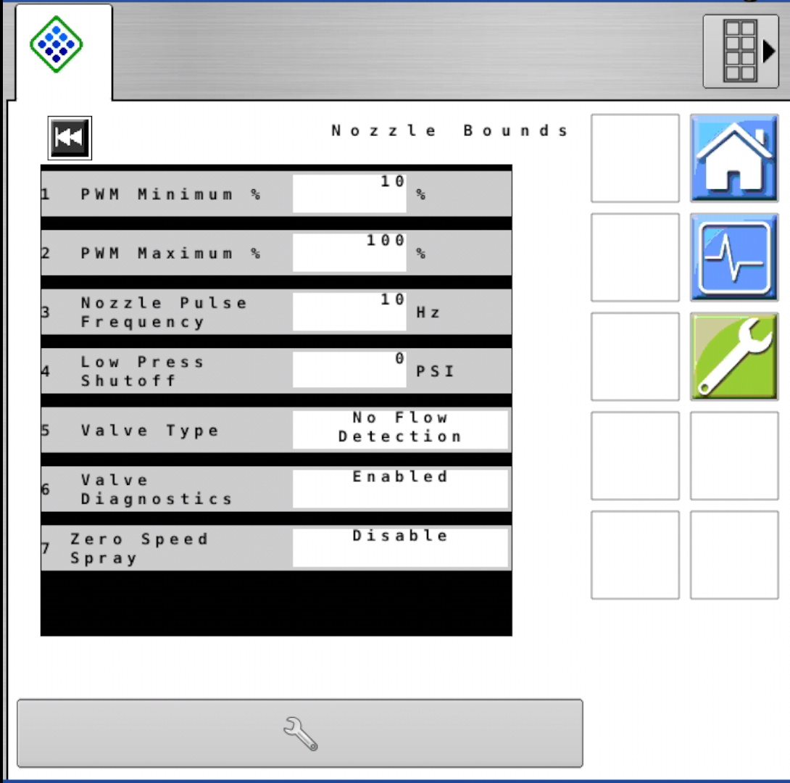
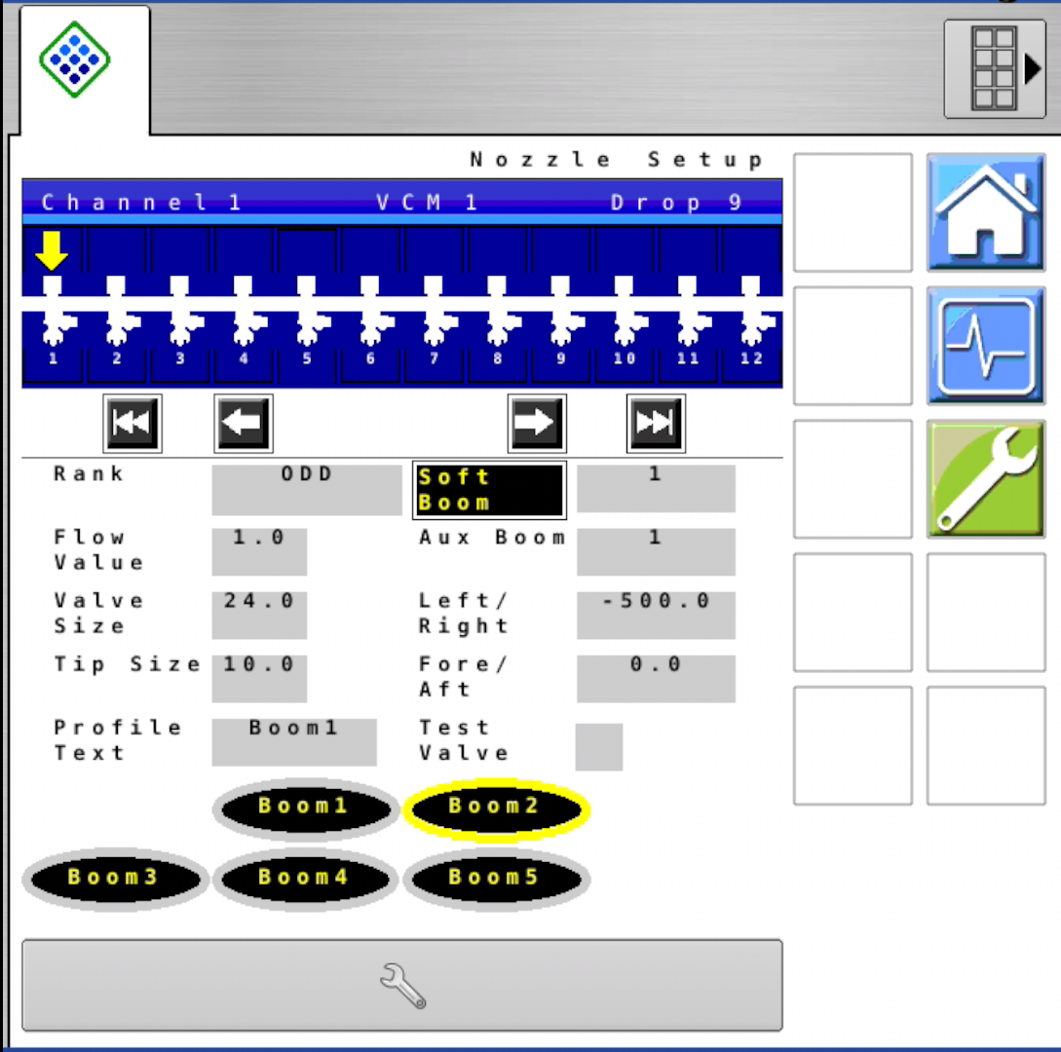
Wrench > Boom/Nozzle > Nozzle Bounds
Wrench > Boom/Nozzle > Nozzle Setup

Slide 3
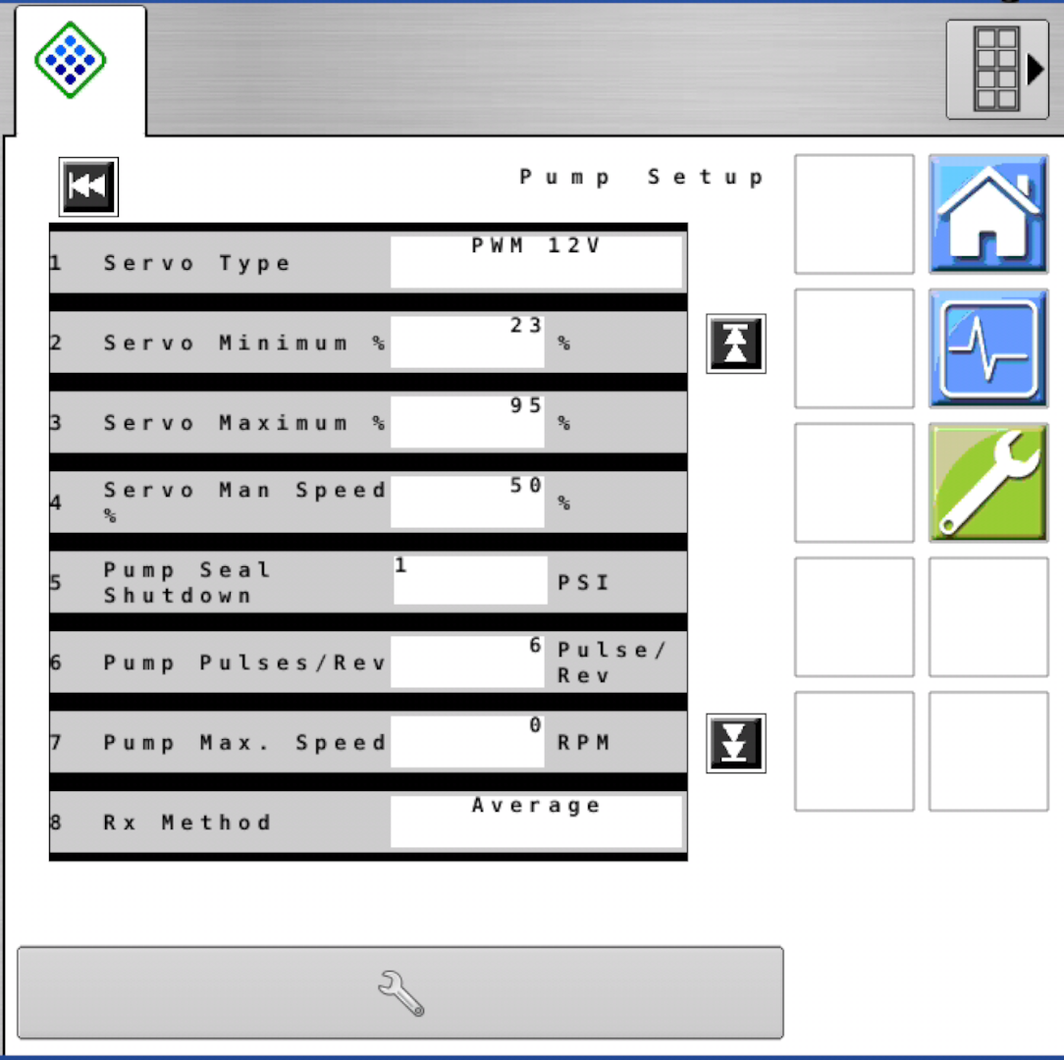
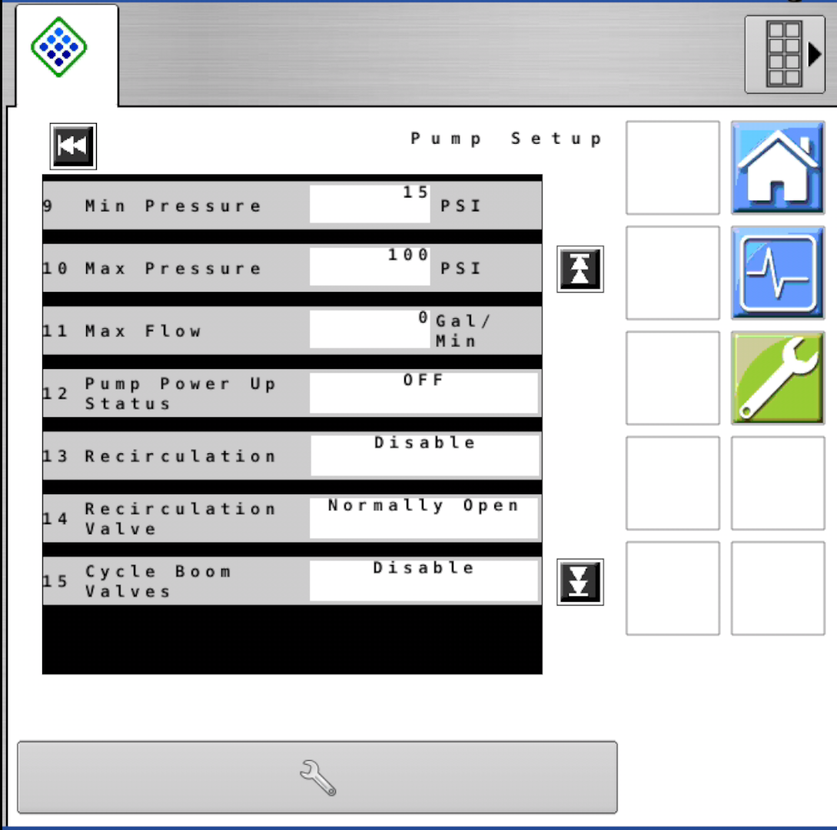
Wrench > Pressure > Pump Setup

Slide 4
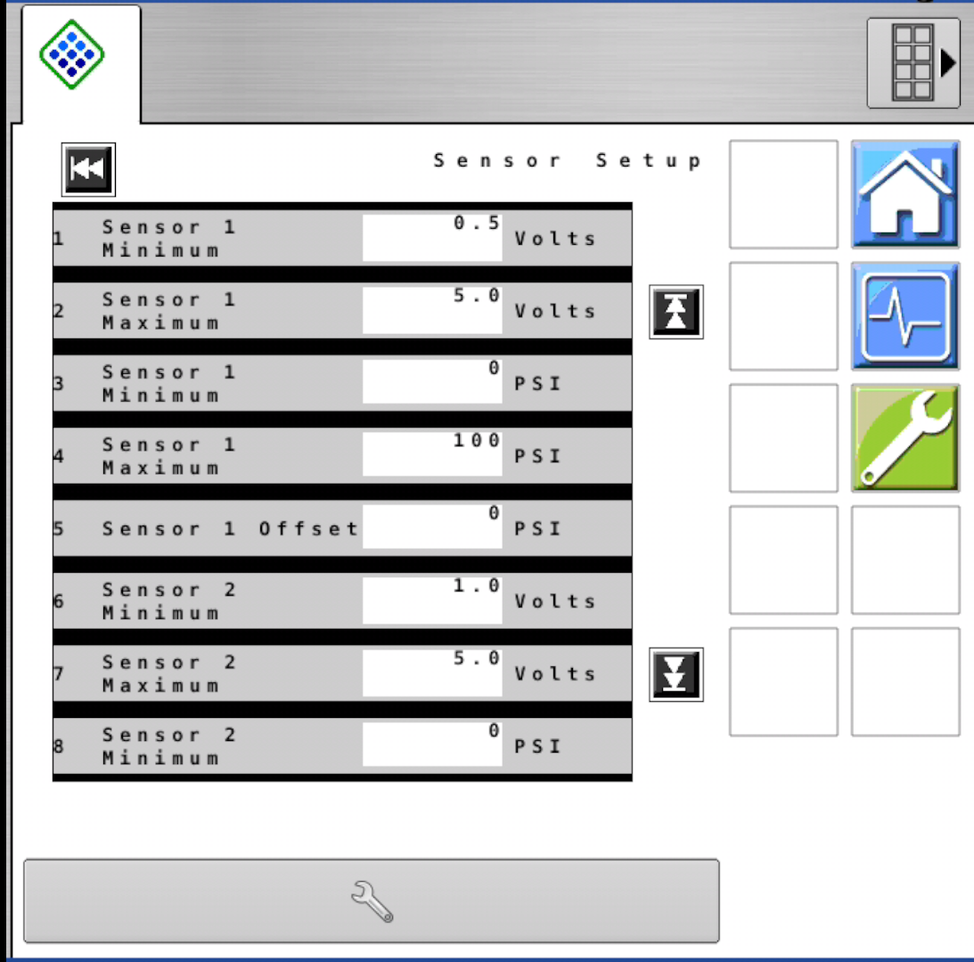
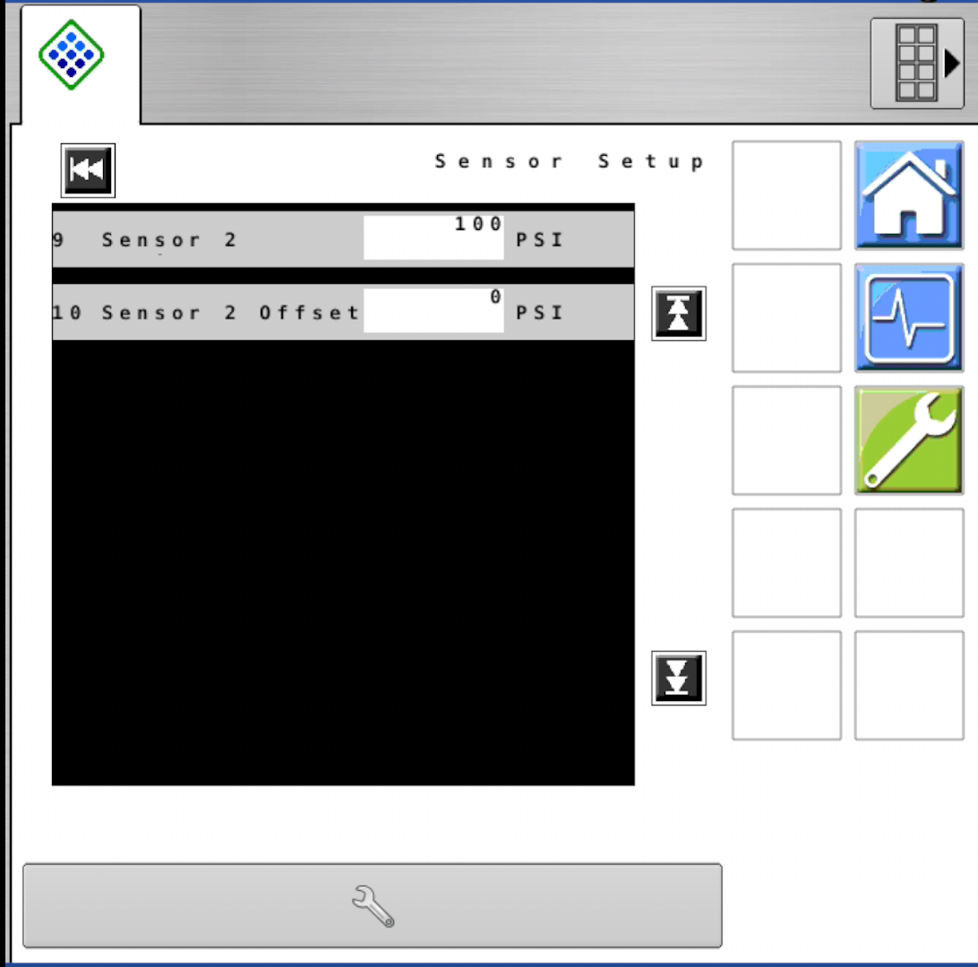
Wrench > Pressure > Sensor Setup

Slide 5

Wrench > Pressure > Control Tuning

Slide 6
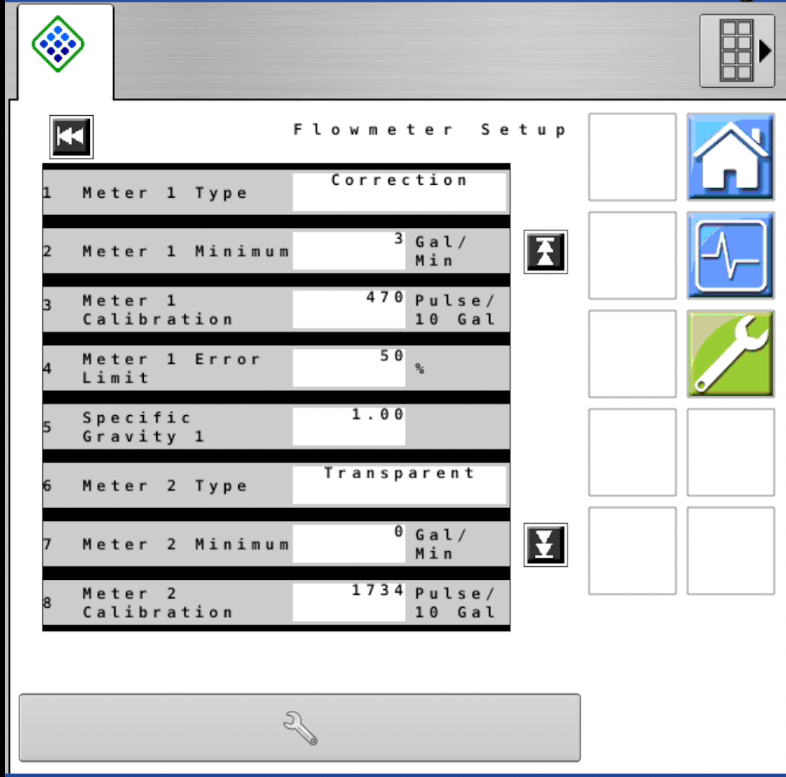
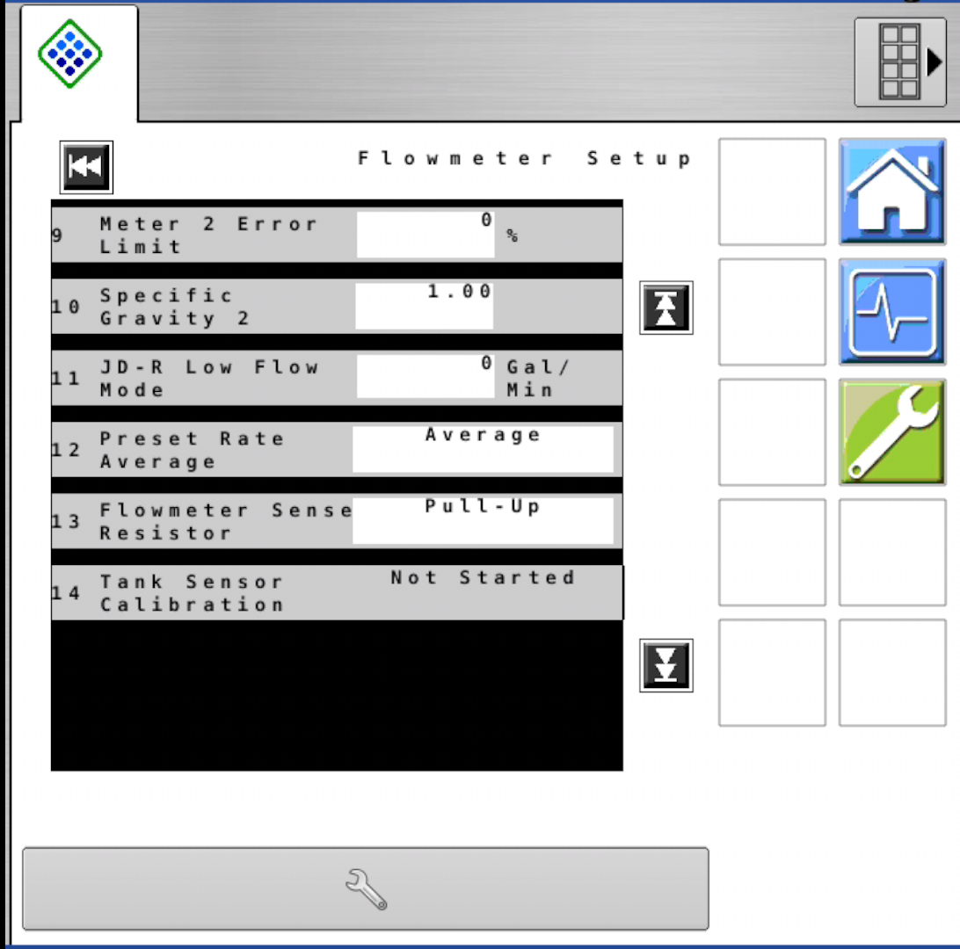
Wrench > Flow > Flowmeter Setup
Machine & Boom Specific

Slide 7
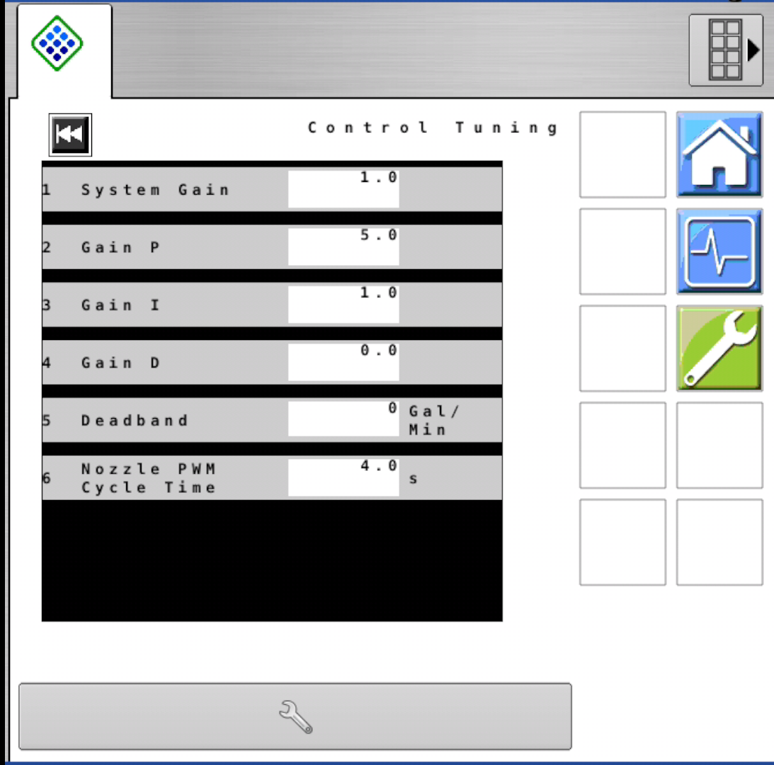
Wrench > Flow > Control Tuning

Slide 8
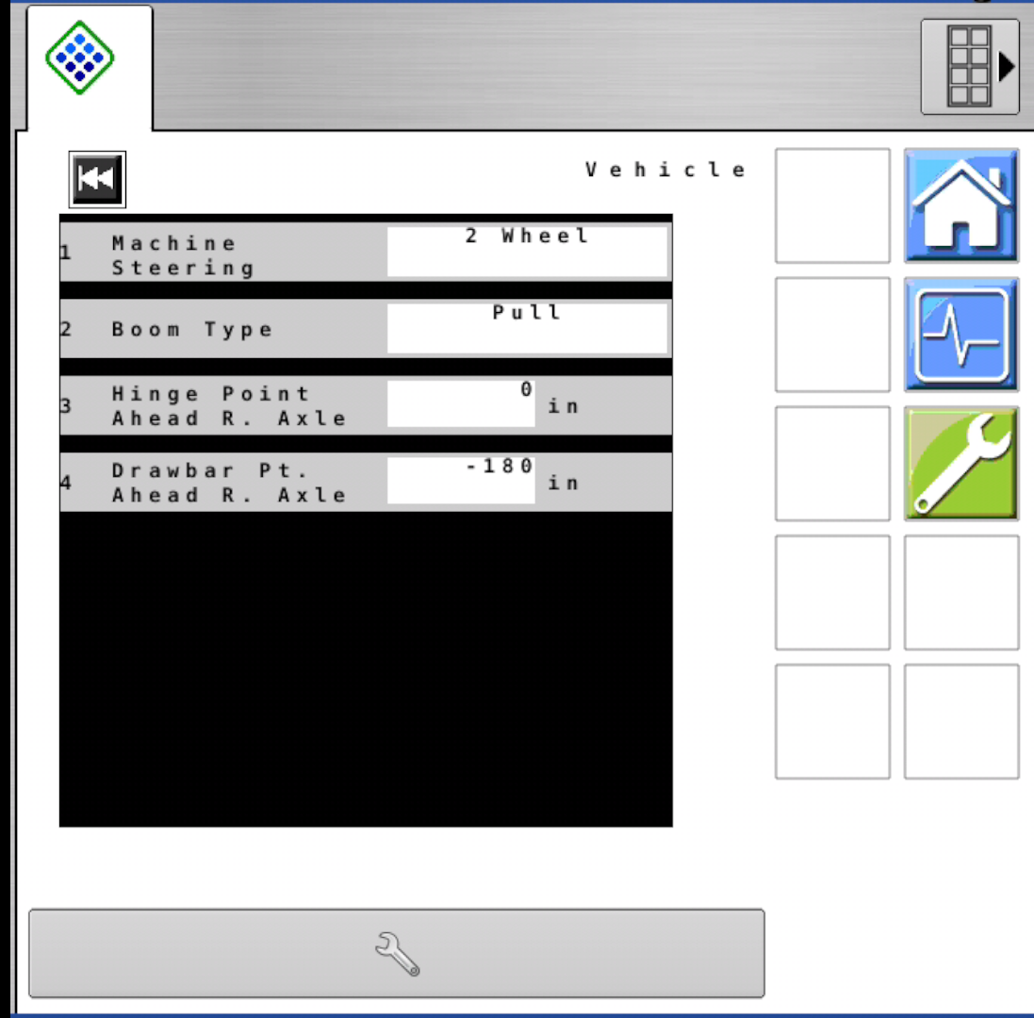
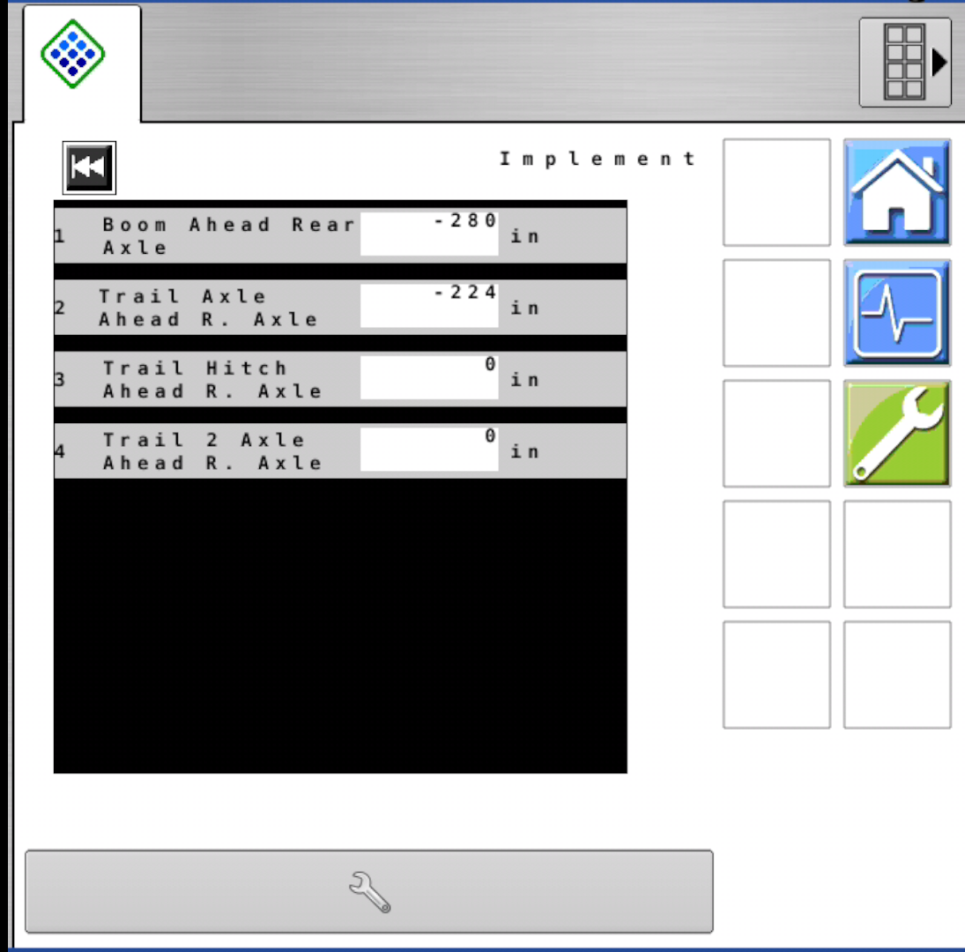
Wrench > Navigation > Vehicle
Wrench > Navigation > Implement
Machine & Boom Specific
Machine & Boom Specific

Slide 9
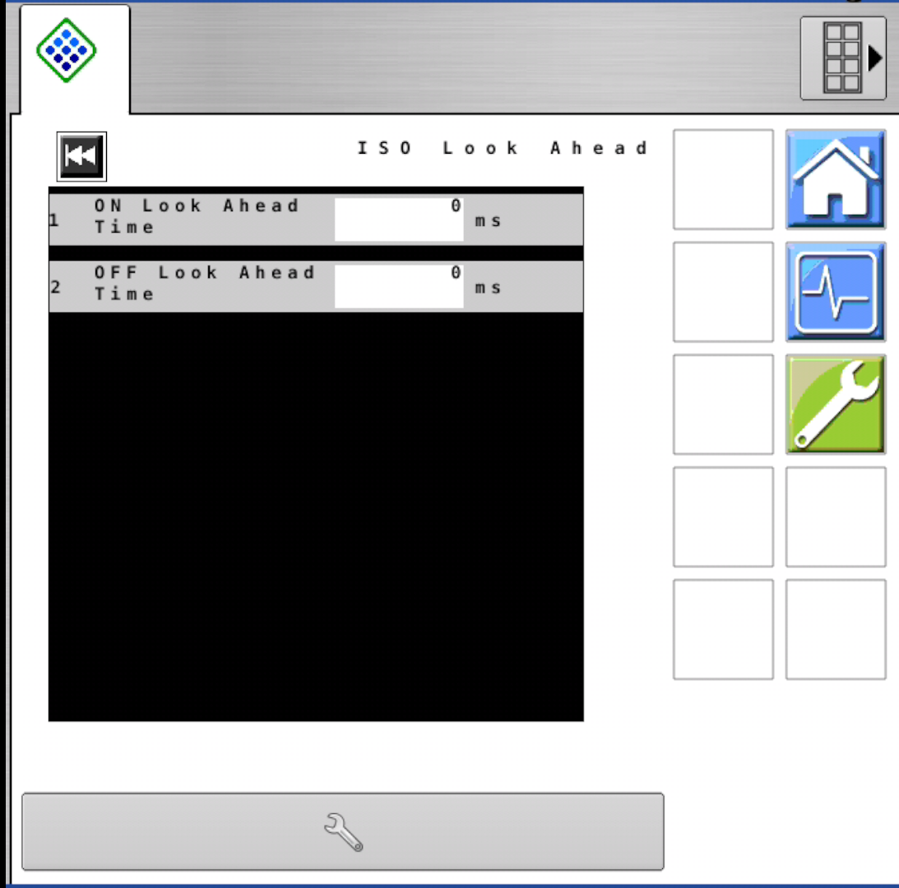
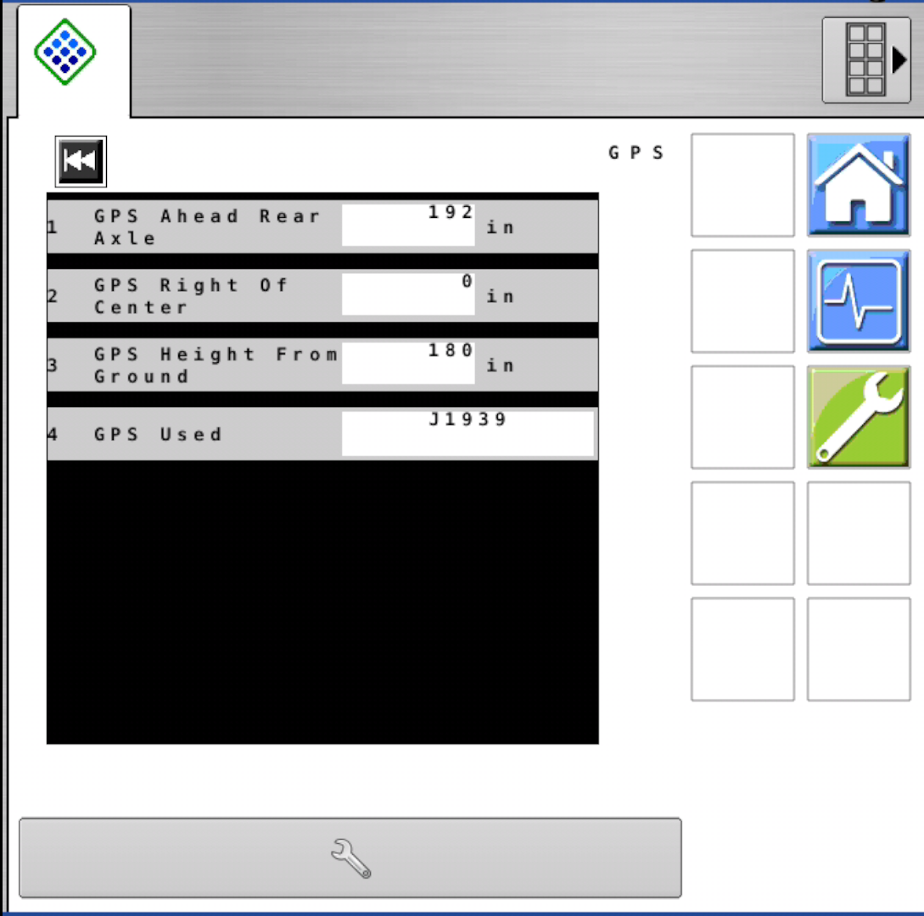
Wrench > Navigation > ISO Look Ahead
Wrench > Navigation > GPS
Machine & Boom Specific

Slide 10
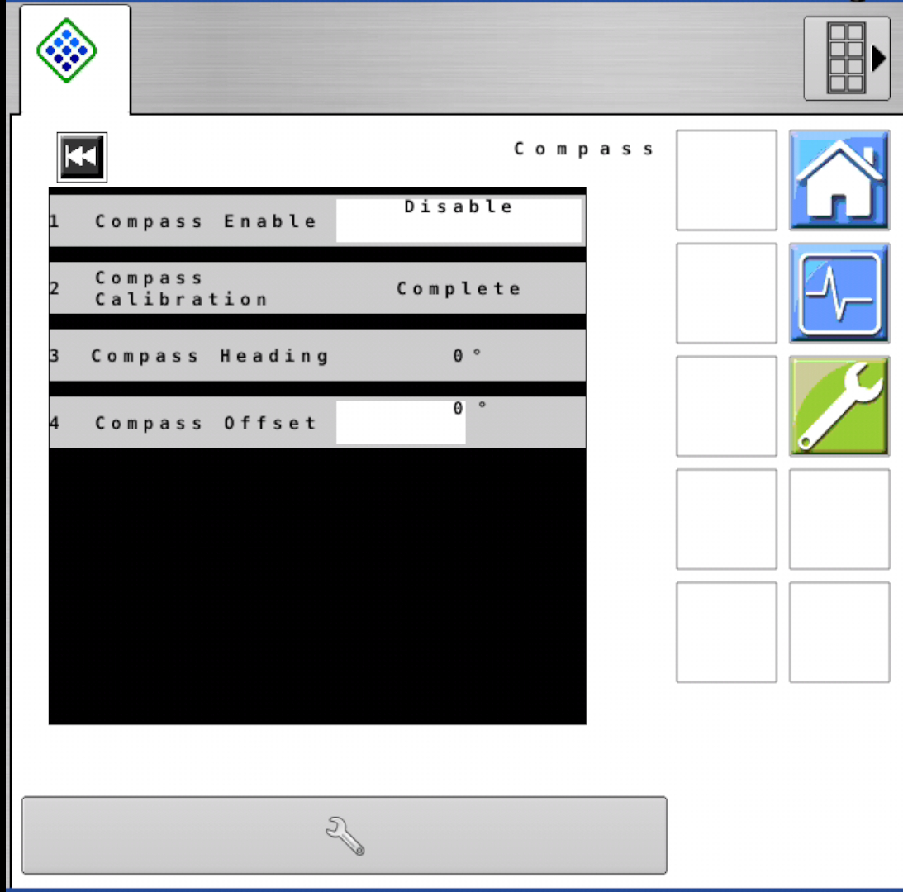
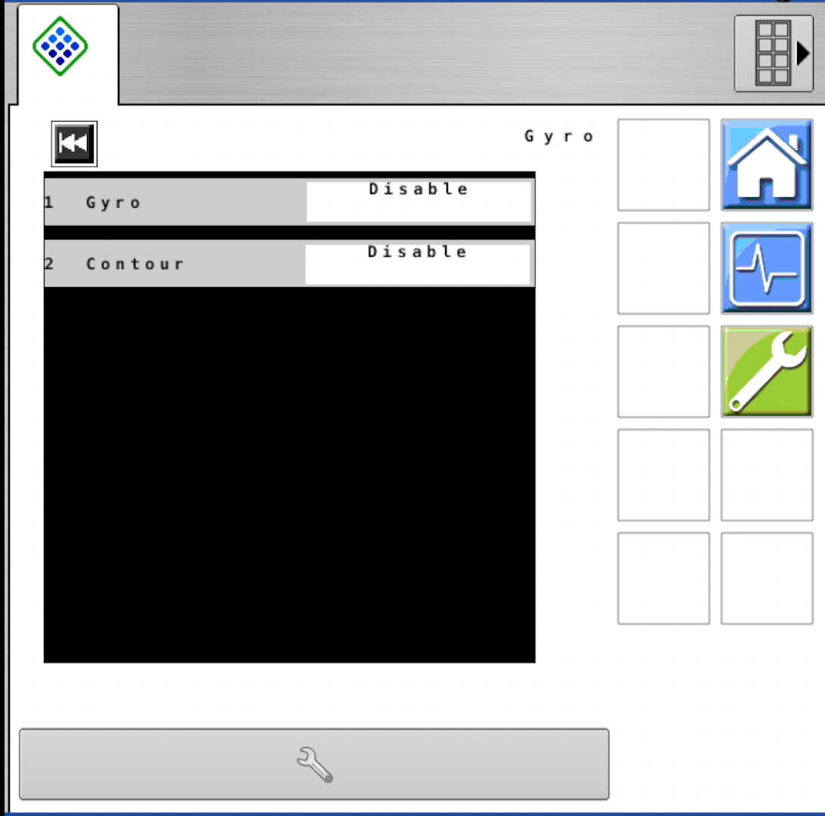
Wrench > Navigation > Compass
Wrench > Navigation > Gyro
Enabled
Enabled

